Slide 1
Feeling Pressured
Peer Pressure and Alcohol Use

Slide 2
Bell Ringer
Thinking back to our media influences lesson, when and how might your peers influence the decisions you make?
Record your response on the blank slip of paper.

Slide 3
Peer Pressure???
Give your best definition of peer pressure.

Slide 4
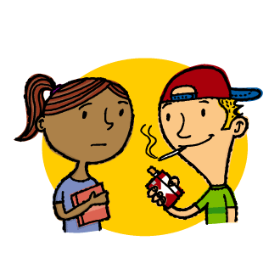
Peer Pressure
Peer pressure is the feeling of being encouraged by your own age group to do something, whether you want to or not.

Slide 5
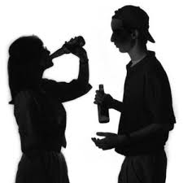
It’s Tough to say “No”
72% of students have had alcohol by the end of high school
37% of students have had alcohol by eighth grade

Slide 6
Ways of saying No???
Question Ball- What are some examples of techniques or strategies you can use to overcome peer pressure?

Slide 7
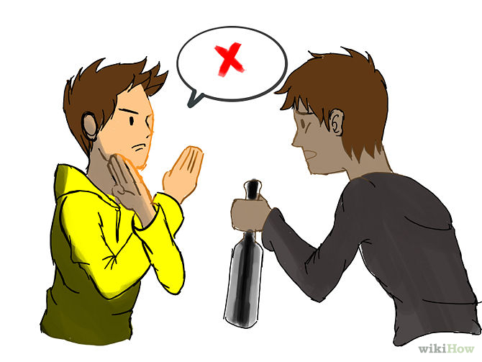
Refusal Strategies
Clear “no” statement
Walk away
Provide a reason
Change the subject
Repeat refusal
Provide an excuse

Slide 8
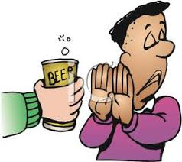
Message Strategies
Clear
Organized ideas/beliefs
Respectful tone
Strong body language

Slide 9
Activity Time!
Each group will be given an alcohol related scenario.
Each group is to create a role-play in response to their scenario, using some of the refusal techniques and message strategies we just discussed.
Be creative and have FUN!

Slide 10
Closure
On the back of your bell ringer slip, write down 2 refusal techniques or message strategies that you think would work best for you, when you are in a pressure situation.

Slide 11
Resources
http://www.teencentral.net/Alcohol/statics.php

