Slide 1
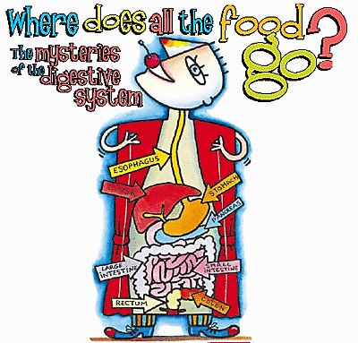
By: Alex Santella, Jim Moran, & Alex Trier

Slide 2
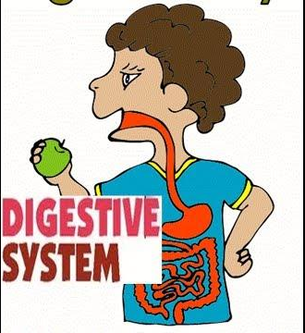
Video!
https://www.youtube.com/watch?v=JnzwbipJuAA

Slide 3
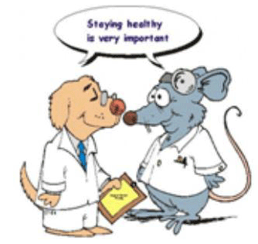
The Digestive System
Mouth
Esophagus
Stomach
SI & LI
Pancreas
Liver
Gallbladder
Rectum
Anus
Notes:
The DS is made up of the mouth, esophagus, stomach, and SI/LI. The purpose of the digestive system is to break down food so that nutrients are absorbed by the body and excrete waste products from the body.

Slide 4
Mouth
Beginning of digestive system
Intake food
Chew the food up into bits of pieces

Slide 5
Trivia!
Q: How much saliva do we make every day?
A:We make 1 to 3 pints of saliva a day.

Slide 6
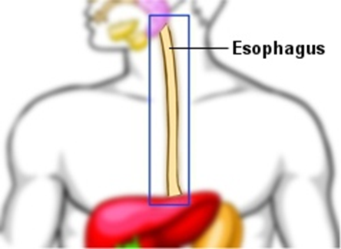
Esophagus
Soft tube that enters the stomach
Mashed up food particles mix with stomach acids and enzymes

Slide 7
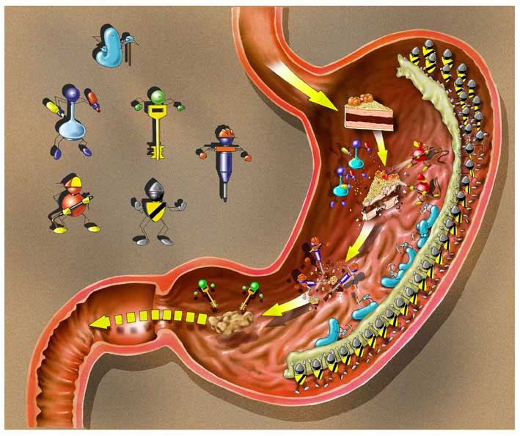
Stomach
Break down food after eating
Mixes foods with enzymes to break it down into useable nutrients

Slide 8
Trivia Question?
Q: How long does food stay in your stomach?
A: 2 to 3 hours

Slide 9
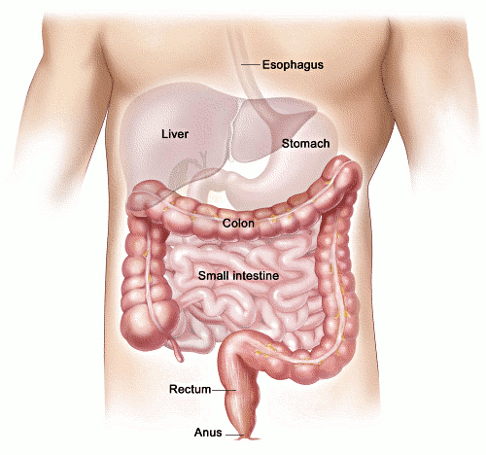
Small Intestine
Most of the digestion process happens
Liver creates bile and removes toxins

Slide 10
Trivia?
Q: About how long is the small intestine?
A: 20-23 feet

Slide 11
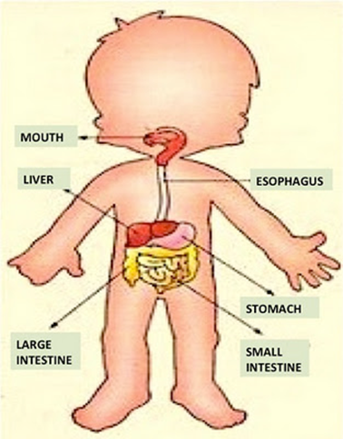
Large Intestine
Water is removed and feces are formed
What substances are not needed go here and unneeded substances are excreted to anus

Slide 12
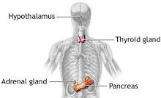
Pancreas
Produces enzymes and hormones that help break down foods
Releases juices to bloodstream

Slide 13
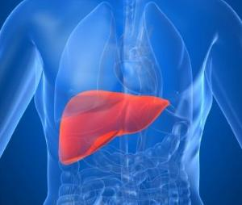
Liver
Stores sugar as glycogen for energy
Produces bile
Filters blood
Notes:
Liver is the largest organ in our bodies. 3 main things that the liver does (bullets)

Slide 14
Gallbladder
Stores and concentrates bile
Releases into the duodenum to absorb fats

Slide 15
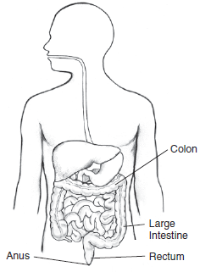
Rectum
Attaches the colon to the anus
Stores wastes temporarily
Ending part of the large intestine

Slide 16
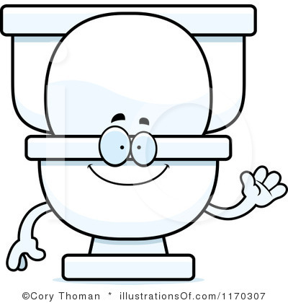
Anus
Last part of the digestive system
Alerts you that it’s time to excrete your waste!

Slide 17
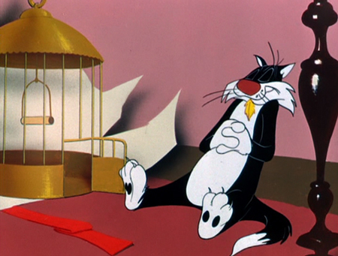
Things That Can Go Wrong
Celiac disease
Diarrhea or Constipation
Irritable bowel syndrome (IBS)

Slide 18
Traveling The Digestive System
Today we will be working as tour guides!
Option to work individually or in a pair
You will be creating a brochure that serves as a “travel guide” for the digestive tract.
Be creative and have fun!

Slide 19
Brochure Criteria
Brochure must include:
Title page
Description, drawing, function, and structure for all seven “locations” in the digestive tract.
Attractiveness
Creativity and Uniqueness
All group members must participate!

Slide 20
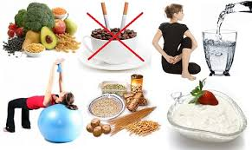
How To Keep Digestive System Healthy
Manage Stress
Exercise regularly
Skip bad habits
Stay hydrated
Eat on a schedule

Slide 21
Food For Thought!
Question Ball!
Name one important “location” in the digestive system and briefly explain the function of that part.

