Slide 1
Analyzing Media Influences

Slide 2
Bell Ringer
List three things/people that might influence our behaviors or decisions.

Slide 3
Influences that Affect Our Choices?
Personal Factors (Beliefs, interests, curiosity).
Culture
Family
Friends
Cost
MEDIA (Television, radio, magazines, newspapers, etc.)

Slide 4
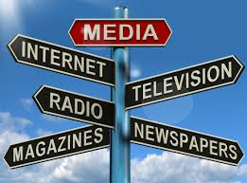
Media

Slide 5
Advertising
Messages designed to cause consumers to buy a product or use a service.
Companies invest a lot of money into ads to persuade you to buy their product.
Ads are designed to influence people!
https://www.youtube.com/watch?v=9xW_-QdL3rA

Slide 6
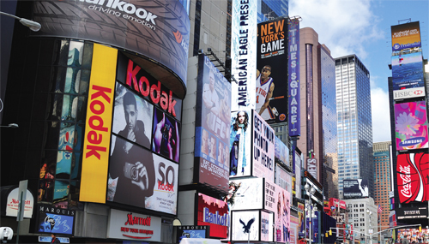
What influence do ads have on you?

Slide 7
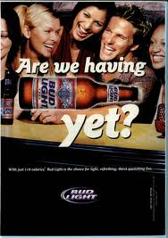
Advertising Techniques (Messages)
Bandwagon- Everyone is using it, you should too!
Beautiful people- you will be like these people, if you use the product!
Good times- You will have fun if you use it!
Status- you will be cool, if you use this brand.

Slide 8
Analyzing Advertisements Activity
Work with a partner to analyze an advertisement.
Complete the question sheet and discuss the strategies used in the advertisement.

Slide 9
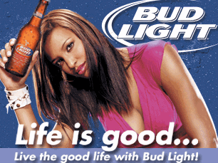
Influence of Advertising
Advertisements might influence…
What we eat/drink.
What we buy.
The clothing we wear.
How about with the use of drugs and alcohol?

Slide 10
Advertising Influencing Alcohol and other drug use
Approximately $6 billion is spent annually on alcohol advertising and promotion.
Beer commercials are virtually custom-made to appeal to children and adolescents, using images of fun-loving, sexy, successful young people having the time of their lives.
Tobacco ads have more restrictions now (used to have cartoon characters).

Slide 11
Closing Activity
Work with a partner to come up with a list of the drug and alcohol content that has been covered in previous health classes you had.

Slide 12
Mindfulness
5 Minutes of mindfulness!

