Slide 1
Tobacco

Slide 2
Bell Ringer
Work on the tobacco crossword puzzle!

Slide 3
Influences on Tobacco Use
Why might some people begin to smoke?

Slide 4
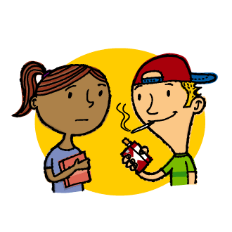
Influences on Tobacco USe
Family
Peers
Identifying role models
Media influences (advertising).
Legal factors (turning 18).

Slide 5
When smokers start?
At what age do the majority of smokers begin smoking?

Slide 6
When Smokers Start?
Almost 70% of adult smokers began smoking before they turned 18.
Most smokers try their first cigarette around the age of 11.
More than 3,600 youth try smoking for the first time on a daily basis.

Slide 7
Short-term Effects
What are some of the short-term effects of smoking?

Slide 8
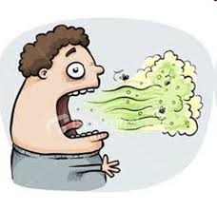
Short-term Effects
Stains teeth, fingers, and lips
Reduces oxygen carried by red blood cells
Shortens breath
Diminishes ability to be physically active
Dulls the senses of taste and smell
Causes bad breath

Slide 9
Long-term Effects
How about some of the long-term effects?

Slide 10
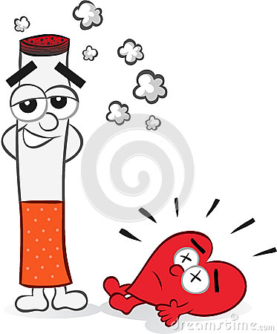
Long-term Effects
Wrinkled skin
Heart attack
Stroke
Chronic lung disease (emphysema, chronic bronchitis)
Cancer (lung, stomach, bladder, mouth, throat)

Slide 11
Other Consequences
Costly for society - $193 Billion (health care costs & lost productivity)
Most preventable cause of death
About 400,000 deaths per year, due to smoking related diseases.
Secondhand smoking causes about 38,000 deaths per year; typically from continuous exposure

Slide 12
Pack it in Activity
Create your own brand of cigarettes.
You must include at least 5 negative aspects of smoking (Short/long-term effects, health consequences).
Be creative and have fun!

